Slide 1
Securing and Protecting IP in The APP Development Domain – ‘navigating the me-too dilemma’
TthThabang Mpye – Head: ICT
24 Nov 2021

Slide 2
Discussion Points
Pervasiveness of Mobile Applications.
Fundamentals of Innovation/Technology Development Support on South Africa – TIA Mandate and Instruments.
Challenges of establishing novelty in Mobile Applications.
Way forward – Can we achieve and implement (practical) a novelty assessment model in the domain of mobile application development?

Slide 3
Global usage of international data bandwidth – by type of provider
100% growth in a decade
Source credit: Digital Economy Report 2021 – United Nations Conference on Trade and Development

Slide 4
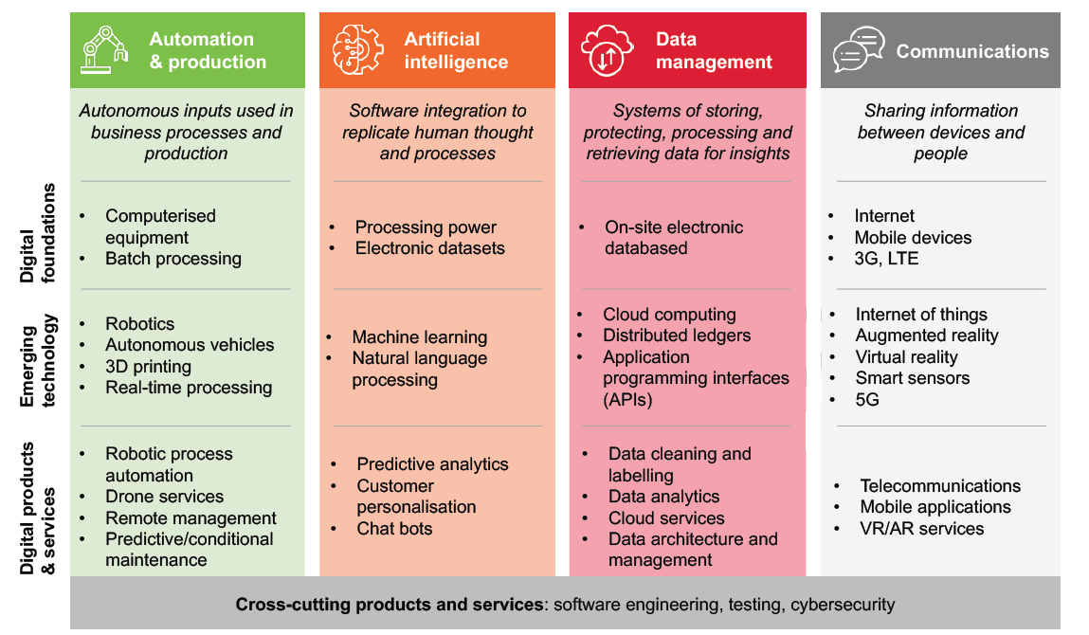
Introduction
Source credit: Genesis Analytics (2020) and RSA DCDT

Slide 5
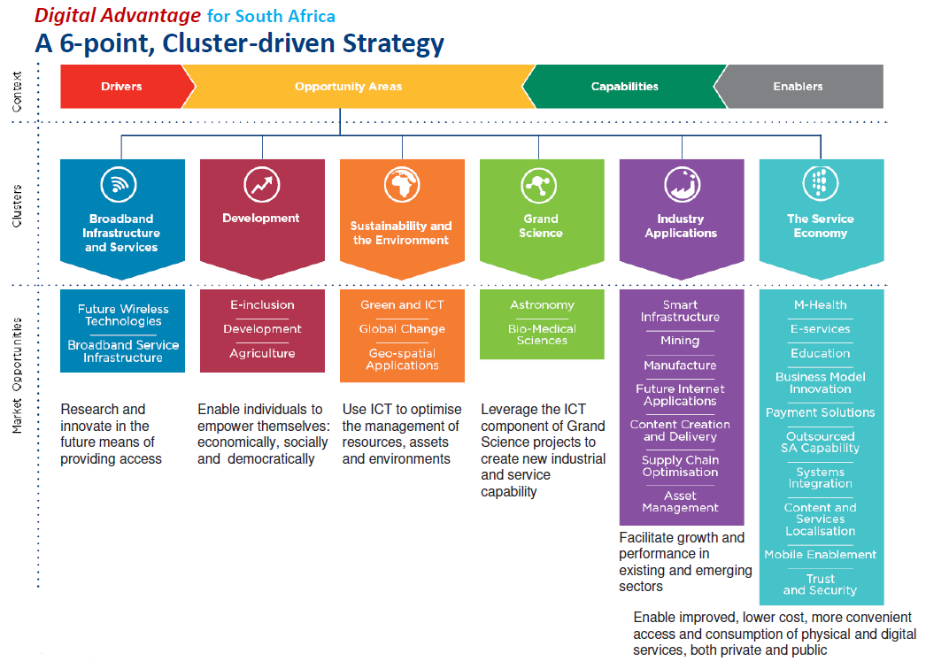
Introduction
Source credit: ICT RDI Roadmap, RSA – DSI, 2015

Slide 6
Classification of Mobile Apps
Gaming and Entertainment
Utility and Productivity
Educational and Informative
Leisure and Lifestyle
Social Media and Communication
Business and e-Commerce
  Fintech Apps
  Education Apps
  Of the 100+ funding applications TIA Commercialisation:ICT received 1 March 2020 – date, approximately 50% are Mobile Application related

Slide 7
Industrialisation (Innovation) Chasm
Pre - 1994 - South Africa could have been regarded as a technology of the ‘second kind’
Post 1994 - South Africa is steadily evolving towards improving the technology transfer flow, albeit the ‘chasm’ towards seamless technology exploitation remains
OVERSEAS TECHNOLOGY SOURCES
RESEARCH
DEVELOPMENT
PRODUCTION
Local Technology Transfer Channel
Local
Activity Level Scale
Local Research Organisations
Post millennium
Industrialisation CHASM !
Activity Level Scale
Local Research Organisations – Post ‘94
Weak Technology Transfer Flow
Local Industry & Industrial Products
Basic Research
Applied Research
Design and Development
Production / Manufacture
Sales
Source: Adapted from Emerging from the technology colony: A view from the south, G de Wet, www.repository.up.ac.za. Accessed 15 May 2021

Slide 8
Funding Instruments
RAPID FUNDING
Source credit: ICT RDI Roadmap, RSA – DSI, 2015

Slide 9
Public IP support and exploitation in RSA
Legislation and governance
Government saw the need of generating protecting (and exploiting) IP Rights (IPRs) from publicly financed organisations, enacting the Intellectual Property Rights from Publicly Financed Research and Development (IPR - PFRD) and TIA Acts.
The acts were emulated from the US’ Bayh-Dole Act whose primary objective was to promote growth of technology-based small businesses by allowing them to own patents from federally sponsored research.
[Source: ‘Is Bayh-Dole Good for Developing Countries? Lessons from the US Experience’, So et al, 2008, PLOS Biology, https://storage.googleapis.com/, accessed 15 May 2021]
TIA - ACT
"to use South Africa's science and technology base to develop new industries, create sustainable jobs and help diversify the economy away from commodity exports towards knowledge-based industries equipped to address modern global challenges"

Slide 10
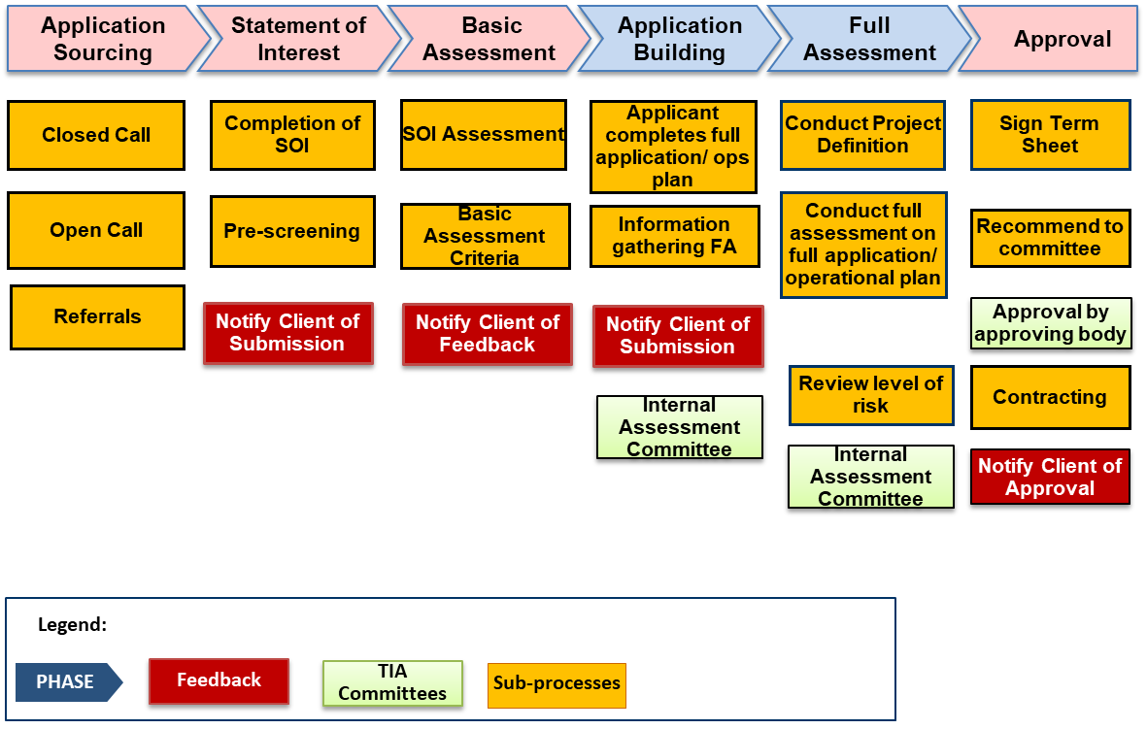
TIA Investment Process - High-level
Source credit: TIA Investment Standard Operating Procedure, 2021

Slide 11
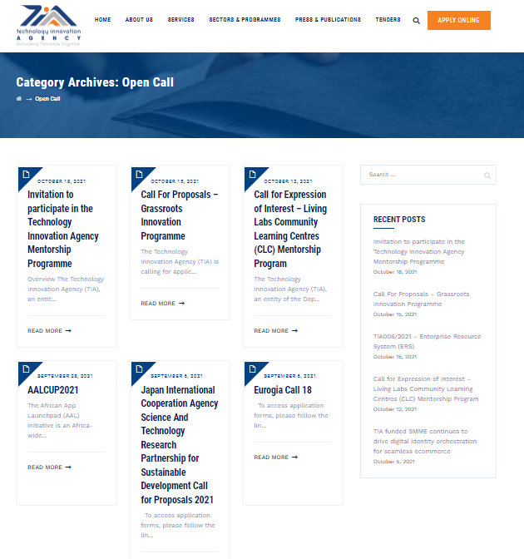
TIA Investment Application attraction
Source credit: TIA – www.tia.org.za

Slide 12
Conclusion
The Mobile App Development landscape is looking ‘green’ – there is vast ideas/initiatives, appetite for consumption (and hence development funding support).
The state is affording the domain decent attention and support.
Innovation: The novelty aspect is still a ‘grey area’ – The most ideas are prone to be perceived as ‘me-too’.
Way forward – Concomitant approach:
  Developers to make an effort to establish Novelty, are at least align their APPs to the social imperatives.
  State and funders to work on polishing their SOI appraisal framework – A quantitative model will be ideal.
IP and Technology Management Academia to research and develop a model?

Slide 13
Q & A
thabang.mpye@tia.org.za

